Slide 1
Playbooks for SFDC Onboarding Kick-off
November 2019

Slide 2
AGENDA
    Introductions
    Governance
    Process & Timeline
    SFDC Requirements
    Next Steps

Slide 3
Introductions: XANT
CSM NAME
Customer Success Manager
Primary point of contact, oversees project kick-off & completion, ensures that the customer receives value with the platform
TC NAME
Technical Consultant
Initial onboarding onto the platform, SFDC + ISDC design & configuration, user training
AE NAME
Account Executive
Assists customer with acquiring more licenses for new teams/departments

Slide 4
Governance via Steering Committee
Set the strategic vision
Make key decisions
Assign action items
Report project accomplishments
Achieve business results

Slide 5
Governance
[Customer]:
  Executive Sponsor:
  Project Lead:
  Sales Ops Leader:
  Sales Manager(s):
  CRM Admin:
  Playbooks Admin:
  Trainer:
XANT:
  CSM:
  TC:
Steering Committee
Meet at project milestones
Set Strategic Vision
[Customer]:
  Project Lead:
  Sales Manager(s):
  CRM Admin:
  Playbooks Admin:
  Trainer:
XANT:
  TC:
Operations Committee
Meet Weekly
Operationalize / Execute Vision
Testers
Power Users
Test / pilot solution
1-2 Users:

Slide 6
Completion VS Success

Slide 7
Average Project Timeline
Activity | W1 | W2 | W3 | W4
Initiate
Design
Build & Test
Launch & Scale
Project Completion

Slide 8
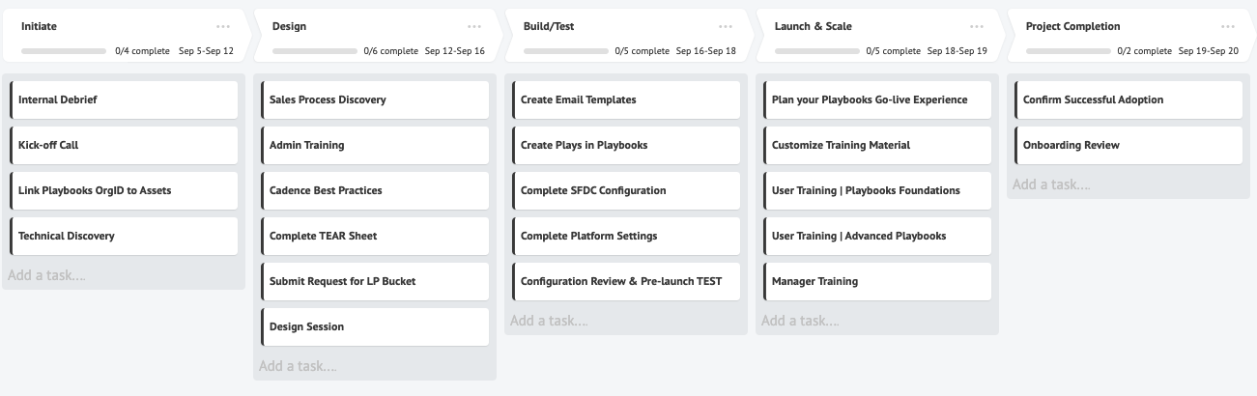
Project Management Application
https://app.beynd.com/app/login

Slide 9
Measuring Success – Business Results
Baseline
Target
Actual
Daily Dials
Contacts
Talk Time
Appointments
Opps Created
Adoption

Slide 10
Review Statement of work (SOW)
Onboarding Scope:
Configurable Software Products/Features
  Play framework & content
  Enrollment strategies (incl. Auto-Enrollment)
  Automation rules
  Email templates
  User/Team Setup & Permissions
  Call Recording settings
  Email tracking restrictions
  Reports and Dashboards via CRM (related to Playbooks) Software Configuration
XANT will work with up to:
  2 users & 1 Admin Licenses
  1 persona
  1 production instance

Slide 11
Salesforce.com Changes
Required
Possible
Activity Custom Fields (7-15)
Work-flow Rules
Integration User in SFDC
Unmanaged Package(s):
List Views
Lead/Contact (4-6)
Reporting
User profile permissions
Additional custom fields
Page Layouts

Slide 12
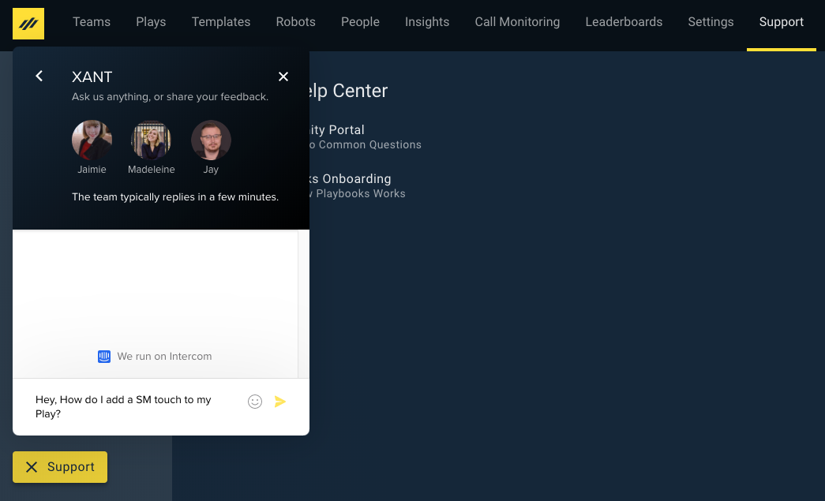
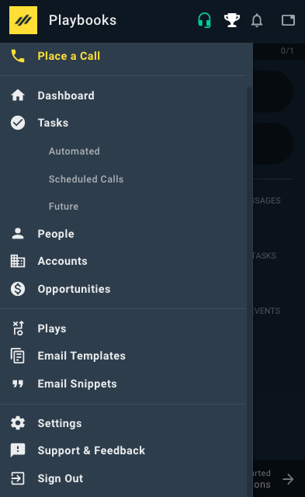
Additional resources
Manager App
1
http://www.helpcenter.xant.ai/
XANT Support:
  Call: 866-593-2807
  Instant Chat from Playbooks Manager app or Extension
Extension
3
2
Support available 8am to 6pm MST to assist with technical matters during & after onboarding

Slide 13
Up Next
TODAY: SFDC Setup & Playbooks Org Creation
  Together: Begin Technical Discovery
  Together: Configure Integration User
  Together: Install Package & Provision your Playbooks Org
  On your own: Technical Discovery Questionnaire
NEXT: Sales Process Discovery
  Together: Understand your current sales process, sales cadence, & CRM configuration

Slide 14
Thank You

Slide 15
Set up Integration user & provision Playbooks org
Decide who the Integration User will be
Save email address on User Detail Page of Integration User in SFDC (Best practice is to create a new email account, but not required)
Provision Playbooks org
Install the Playbooks Unmanaged SFDC Package
Log into Manager App and complete first-time user experience in Manager App (Connect to SFDC)
Create a team and add the Integration User to the team
Install extension
Log into extension & complete first-time user experience (Connect to SFDC & Email)

