Slide 1
Playbooks Onboarding Review
November 2019

Slide 2
Value Delivered
Launched team on Playbooks
Systematized Cadence
Automated Voice Messages
Email Templates
Local Presence
Call Recordings
User Training Sessions & 1:1 coaching for all users
Configured new Reports in Salesforce to track Playbooks activities
Held Management Training/Strategy sessions
Call Monitoring
Driving superior performance using Playbooks reports in SFDC
Email Template / Play strategy
Gamification Discussion
Delivered documentation: Cadence Best Practices, User Training deck, Manager Training deck, Playbooks New User Checklist

Slide 3
Recommended Next Steps
CRM and/or Playbooks Configuration:
[Any outstanding item]
Strategic Decisions:
How often will you review Plays as a team & deploy new Plays?
What team competitions do you want to run each month to encourage continued performance?

Slide 4
Recommended Playbooks Support plan
User
Peer
Manager
Sales Ops
Case XANT Support
CSM
Go to http://helpcenter.xant.ai/ anytime!

Slide 5
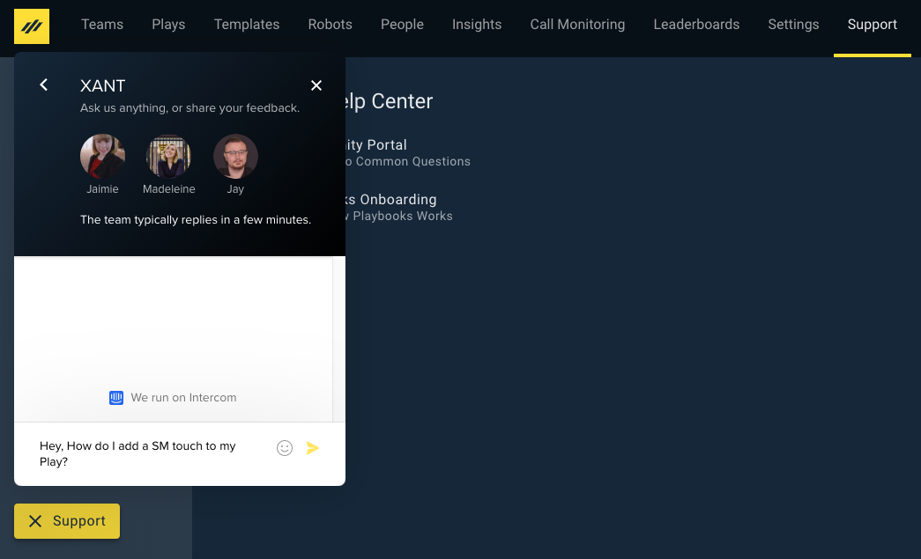
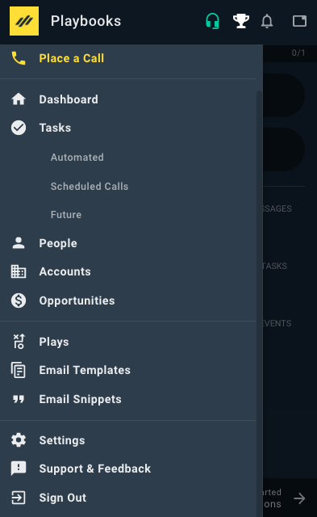
Additional resources
Manager App
1
http://www.helpcenter.xant.ai/
XANT Support:
Call: 866-593-2807
Instant Chat from Playbooks Manager app or Extension
Extension
3
2
Support available 8am to 6pm to assist with technical matters during & after onboarding

Slide 6
CXM Engagement Plan
Business Value Reviews
Best Practice Consulting
Meetings & Frequency:
Meet at least every quarter
Business Value Review (BVR) once per year
Contract Renewal once per year
CSM available via email & phone
Technical Consultant will engage as needed
Support available at all times
Resource and Community Engagement
Customer
Success
Manager
Feature Deployment
Strategy Questions
Governance and Center of Excellence

Slide 7
Thank You

